Slide 1
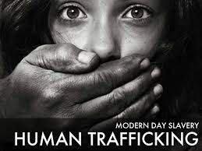
Human Trafficking in 21st Century
Unity Tour = Friday, 9/6/2024 in Plano, TX at 5:30 PM & Saturday, 9/7/2024 in Lubbock, TX at 5:30 PM
Insights 21 Podcast = www.Insights21.com or
www.DrMichaelJFredrick.com
Dr. Michael J Fredrick, LLC
Insights 21 Podcast Email: mjfinsights21@gmail.com

Slide 2
Armor of God Prayer
Heavenly Father, today we put on the full armor to protect us against attack. We put on the belt of truth to protect against the lies and deception. We put on the breastplate of righteousness to protect our hearts from the temptations. We put the gospel of peace on our feet to walk in your light, peace, and freedom with the Holy Spirit. We rebuke anxious thoughts. We take up your shield of faith for protection to block and destroy all the darts and threats thrown at us by the enemy. We put on the helmet of salvation to cover our minds and thoughts reminding us that we are children of a mighty king. We are forgiven, set free, saved by the blood of Jesus. We take up the sword of the Spirit. Your living word that has the power to demolish strongholds and is sharper than any double-edged sword. We come to you Lord in prayer daily in Jesus mighty name we pray. Amen.
–Emma, The Imagination Podcast
Dear Lord, you are our wonderful creator. The God who is always with us, always protecting us and always pushing us to be who you created us to be. Protect us and this podcast (tour) today and anyone listening in the future from spirits who wish to divide, bring negativity or crush the Holy Spirit that lives within us all. Please speak to us today as to bring the messages you need others to hear. We ask this in Jesus name. Amen. –Becky & Bridget from Phoenix, AZ, Save Our Children Podcast & Emma, The Imagination Podcast & Stand By Survivors LLC

Slide 3

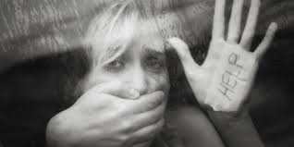
HT = Modern Slavery = #1 Problem in World CAbuse
*Traffickers use force, fraud, & coercion to obtain labor or commercial sex acts.
Labor Trafficking
Drugs
Weapons
Human Trafficking HT = Child Sex Trafficking
$150B – $1+ Trillion a year Business, 1 million USA/8m kids worldwide
HT operates in every city & state in the US & around the world (every zip code) = every 30 seconds a child goes into HT network (2-7 years)
“Human Trafficking is the funding mechanism of the New World Order.” -Cathy O’Brien

Slide 4
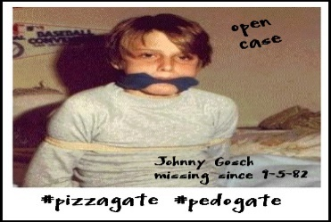
Human Trafficking Books HT in the Midwest – Elite Pedophile Networks:
Human Trafficking, Pedo-Satanism, Satanic Pedophilia:
The Franklin Scandal: A Story of Powerbrokers, Child Abuse, & Betrayal (2012) by Nick Bryant
*Rabbit Hole: A Satanic Ritual Abuse Survivor’s Story (2012) by David Shurter (Hummel Park, Forest Lawn Cemetery) &
*Documentary: David’s Story – The Childhood Ritual Abuse of David Shurter - SRA survivor read book (Omaha, NE)
*The Franklin Cover-Up: Child Abuse, Satanism, & Murder in Nebraska (2011) by John W. DeCamp (Omaha)
*Why Johnny Can’t Come Home: Kidnapped while delivering newspapers…Forced into pornography, prostitution, mind control, & espionage (2024, 2000) by Noreen Gosch – Story aired on tv in November, 20 1992 & May 25, 1993 on AMW America’s Most Wanted
60 million children survivors USA molested by pedophiles

Slide 5

Ted Gunderson, retired FBI
“I can state without hesitation that there is indeed a National cult network including Satanic, witchcraft, and occult groups which is operating with a full throttle within our society today. The activities of these groups include the kidnapping, the molestation, torture and murder of children. Their favorite victims are young children and new-born babies. The younger the better! The cult thrives on drug sales, pornography, and prostitution. The cult network is responsible for the recent rash of snuff films which are sold at high prices to people who crave the sick, degenerate material. Children are kidnapped and literally owned by the cult and are sold on the open market to the highest bidder. These children are taken right off the streets of our cities and traded through a national pedophile network.” -Ted L Gunderson, special FBI agent, LA, retired

Slide 6
Kerth Barker Quotes
“A former FBI special agent named Ted Gunderson found out that Satanic cults did exist and that some of them were performing human sacrifices. He tried to inform the authorities and they ignored him in spite of all of his evidence and credentials. He tried to take this information to the public and was ridiculed as a conspiracy theorist. He was a true American hero because of his efforts.” ― Kerth Barker
“One of these Technocrats had hacked into a laptop at a Bilderberg Group conference and listened into a conversation between a Rothschild and a Rockefeller. This conversation was about the different ways they planned to use surgical mutilation on their own loyal members.” ― Kerth Barker
“Illuminati psychiatrists believe is that when a person is subjected to extreme surgical mutilation, this creates a permanent feeling of powerlessness. So when a mutilated person is then subjected to indoctrination, that person will accept hypnotic suggestions and propaganda more willingly.” (ex. Dolls = no arms, legs)

Slide 7
Top 5+ Movies related to Snuff Films:
1 Red Room (2019) = Amy Kelly - Held captive in an isolated house in rural Ireland, 4 kidnapped girls must escape their impending deaths at the hands of sadistic killers. Movie about torture and snuff films sold online.
2 *Human Herd (2018) Kelly is called in to work when her co-worker Sam goes missing. Abducted by a ruthless gang of bikers and sold to cartel for human trafficking, Kelly is shipped off to a buyer far from home who has an insatiable appetite for pretty young girls.
3 Hostel 3 (2011) Presented by Quentin Tarantino (Kill Bill, Vol. 1 & 2) and directed by Eli Roth (Cabin Fever), Hostel is a shocking and relentless film in the tradition of Saw about two American backpackers (Jay Hernandez, Friday Night Lights and Derek Richardson, Dumb and Dumberer) in Europe who find themselves lured in as victims of a murder-for-profit business.
4 Hostel 2 (2007) Presented by Quentin Tarantino (Kill Bill, Vol. 1 & 2) and directed by Eli Roth, Hostel is a shocking and relentless film in the tradition of Saw about two American backpackers in Europe who find themselves lured in as victims of a murder-for-profit business.
5 Hostel 1 (2006) Presented by Quentin Tarantino (Kill Bill, Vol. 1 & 2) and directed by Eli Roth, Hostel is a shocking and relentless film in the tradition of Saw about two American backpackers in Europe who find themselves lured in as victims of a murder-for-profit business.
6 *8 MM (1999) Nicolas Cage uncovers Elite HT network, Snuff films

Slide 8
Kathy “Katy” Groves = CIA Child Snuff Survivor, Central Texas
Katy talks about Uncle Sam’s Snuff Factory located in Central Texas (about 45 minutes away from Austin, TX). Located on a farm and mostly underground. People find it hard to believe that Child Snuff and Snuff Films exist by high ranking government and military officials. DUMBS are where the snuff films are filmed to be sold on the black market or dark web for Gore Whores & Snuff Kings who watch it are unfathomable to most people. Unfortunately, that is a reality that I know too well. I spent 17 years of my life in that world and witnessed 1000s of murders mostly of children of color who were systematically targeted by their race by the racist government across the United States. Uncle Sam’s Snuff Factory (US propaganda) or The Genocide Factory was the literal definition of Hell of Earth. There are other places like it all over the world where I have been trafficked as well. There is no place like Uncles Sam’s where anybody can get whatever they want with the right connections. I’ve seen rich, aristocratic women order children of color cooked to be delivered in a wing of the place called Cannibals Kitchen.
-Uncle Sam’s: An Insider’s Report from the Hell of Monarch Mind Control (2023) by Dr. Marcel Polte

Slide 9
HT Quotes
FACT: Human trafficking is happening in our communities – HT Everywhere in every city, state, the suburbs, and small towns.
*“Anyone who hurts the children does the Devil’s work.” –Jon Wedger, SRA police detective, Hero for the children, The Great Reveal (2023)
Human trafficking is common in college towns, state capitals, & near military bases (liquor stores, alcohol, tobacco, illicit business = strip clubs, massage parlors, brothels, street & internet prostitution, child sex trafficking) because drugs and sex are in demand and for sale (supply & demand business).
Man camps & military bases attract human trafficking, prostitution and child sex trafficking (extraction industries of oil and natural gas mainly in the North & West = Montana, Wyoming).
“Human trafficking is horrific, absolutely horrific but it is a symptom of something much bigger…Child abuse I could say is probably the root cause of 90% of all the hell in the world…” -John Paul Rice, Remember the Titans, Hunger Games, A Child’s Voice

Slide 10
Child Abuse = MPD, DID, Trauma-based Mind Control
It Ends With Us (2024) = movie about overcoming child abuse
"Twenty-Two Faces: Inside the Extraordinary Life of Jenny Hill and Her Twenty-Two Multiple Personalities." (2024, 2012) by Judy Byington
Split (2022) movie about MPD, DID 23 identities live in his body
Miss America by Day Documentary (2019) by Marilyn Van Derbur
Miss America by Day: Lessons Learned from Ultimate Betrayals and Unconditional Love (2003) by Marilyn Van Derbur
The Minds of Billy Milligan (1995) by Daniel Keyes
Sybil: The Classic True Story of a Woman Possessed by 16 Personalities (2009) by Flora Rheta Schreiber
Sybil (1976) = TV movie about Dissociation, MPD, DID with Sally Field, Joanne Woodward
Chinatown (1974) = movie about realities of corruption in 1930s Hollywood & how wealthy are above the law and do what they want including pedophilia with their family - Jack Nicholson, Faye Dunaway, John Huston
The Three Faces of Eve (1957) = doctor treats patient (Joanne Woodward) with MPD

Slide 11
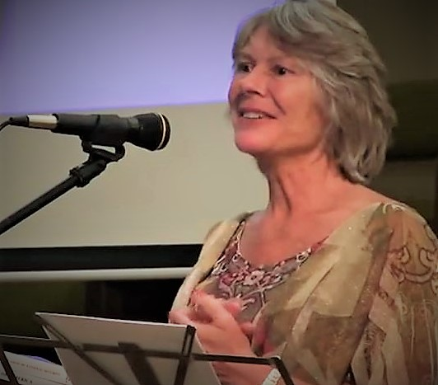
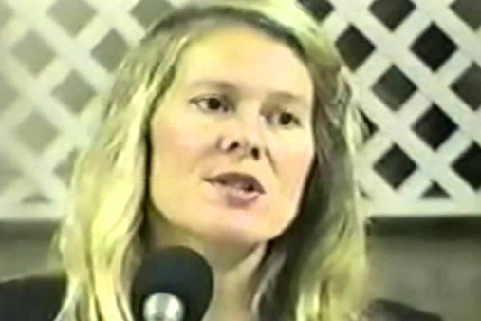
Cathy O’Brien = Michigan
TRANCE (2022) The Cathy O’Brien Story @ www.TRANCE.movie = Documentary film TRANCE who spoke about Jesuit programming cooperating with the CIA
*TRANCE Formation of America: True Life Story of a Mind-Controlled Slave (1995) by Cathy O’Brien & Mark Phillips
Access Denied For Reasons of National Security: Documented Journey from CIA Mind-Controlled Slave to US Governement Whistleblower (2004) by Cathy O’Brien & Mark Phillips
PTSD: Time to Heal (2016) by Cathy O’Brien
website @ www.trance-formation.com
*Behold a Pale Horse (1991) by William Cooper

Slide 12
Cathy O’Brien & Mel Gibson quotes
*Child sex trafficking funds and fuels the New World Order slave society agenda. I know. I am a survivor of it and it has been going on my whole life. It is a blackmail op and a mind control op, and awareness is the first step toward positive, necessary change. -Cathy O’Brien, MK Ultra Monarch Nazi Mind Control, SRA, Survivor
“Our world has been shaped by pedophiles, perverts, criminals, and global elite power mongers for decades. Bringing these dark secrets into the light of conscious awareness is imperative for diffusing the powers that have been in control of U.S., our information, our government, and our children for so long.” -Cathy O’Brien, www.TRANCE.movie
Worldwide, children are stolen and sold to elite pedophile rings. They are tortured, raped, & murdered as part of satanic ritual ceremonies. The murderers then drink the children’s blood and they eat their flesh. The blood of children who were severely traumatized before they died, contains Adrenochrome: a natural drug produced by the pineal gland in the brain. Adrenochrome is the highest valued drug in the world. The God these people serve is satan. It’s not a God of love and mercy… -Mel Gibson

Slide 13
Adrenochrome 6 related movies:
1 “The Substance” (2024) = Demi Moore movie about the Party Substance = A/C
2 Dr. Sleep (2019) – Ewan McGreggor, Mary Astor, Rebecca Ferguson – A cult who feed off the “shine” of innocents by violence to children being tortured to death (Adrenochrome harvesting) in their quest for immortality. Movie related to The Shining (1980) directed by Stanley Kubrick who also directed Eyes Wide Shut (1999) with Tom Cruise & Nicole Kidman.
3 Jupiter Ascending (2015) – Mila Kunis, Channing Tatum must fight to protect the inhabitants of Earth from an ancient and destructive industry.
4 Monster’s Inc (2001) – Sully and Mike are the top scare team at Monster’s Inc., the scare processing team in Monstropolis. G-rated children’s film about Adrenochrome harvesting.
5 *Fear and Loathing in Las Vegas (1998) – Johnny Depp, Benecio Del Toro – An eccentric writer and his lawyer embark on a drug-laced (Adrenochrome) journey to Las Vegas in search of the American dream.
6 Death Becomes Her (1992) – Bruce Willis, Goldie Hawn, Meryl Streep – Story of 2 women who both drink an immortality (treatment) potion (Adrenochrome) and try to win the heart of the same man.
7 A Clockwork Orange (1962) novel by Anthony Burgess (1971) film by Stanley Kubrick - In Anthony Burgess’ 1962 novel A Clockwork Orange, "drencrom" (presumably the Nadsat term for adrenochrome) is listed as one of the potential drugs that can be added to milk-plus (milk laced with a drug of the consumer's choice).

Slide 14
MK Ultra Mind Control & SRA
Systematic mind control has permeated all aspects of society, continually reshaping our perception of reality. This infiltration began in 1947, when Project Paperclip was ushered into the United States, coinciding with the inception of the CIA and the National Security Act. -Cathy O’Brien www.TRANCE.movie
MK Ultra = is the mind control program created by the CIA. Through torture, hypnosis, rape, and heavy drugging, soldiers were “created” for special government operations. Agents often have memory loss. Many believe the CIA still practices manipulating human consciousness.

Slide 15
SRA defined
SRA = Satanic Ritual Abuse = Ritualistic child abuse is the most hideous of all child abuse. The basic objective is premeditated – to systematically and methodically torture and terrorize children until they are forced to dissociate. The torture is not a consequence of the loss of temper, but the execution of well-planned, well-thought out rituals often performed by close relatives. The only escape for the children is to dissociated. They will develop a new personality to enable them to endure various forms of abuse. When the episode is over, the core personality is again in control and the individual is not conscious of what happened.
Satanic Ritual Abuse (SRA) is the extremely sadistic sexual, physical, emotional and spiritual abuse of children and vulnerable adults in the worship of Satan by blaspheming God through mocking the death and resurrection of Jesus Christ. –Lisa Meister, Only God Rescued Me
*Telling the Truth requires Courage not perfection!

Slide 16
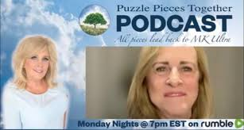
Laura Worley
Puzzle Pieces to The Cabal, Mind Control, & Slavery: Putting it all together for Peace, Healing, and Freedom (2021) by Laura Worley
Puzzle Pieces Together: Manual – A Pathway to Freedom (2023) by Laura Worley
Puzzle Pieces Book 3 (2024) by Laura Worley
Puzzle Pieces Together Podcast with Laura Worley on Rumble = Mondays at 7 pm EST
Healing Workshops website @ www.laurajworley.com

Slide 17
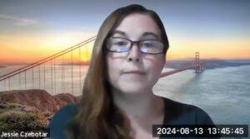
Jessie Czebotar
Foundations of Kingdom Living (2024) by Jessie Czebotar
*An Illuminati Primer (2022) by Veronica Swift
website @ www.illuminatethedarkness.com & classes, Sigils courses, books
@ www.kingdomlivingwithjessie.com
Aquarius Rising II Africa Aquarius Rising Africa II = Chantelle Meyburgh, Morne Venter interviews with Jessie Czebotar, SRA Overcomer
The Reveal Report on Youtube = with George Iceman & Jessie Czebotar
Dark Outpost now The Awake Nation with David Zublick, Penny LA Shepard web @ www.awakenation.tv
Timothy Charles Holmseth = infiltrated “The Finders” & Epstein. He is an FBI witness in a national profile kidnapping case. He captured rogue CIA and FBI child traffickers on tape discussing their operations. He has been targeted for a decade & website @ www.timothycharlesholmseth.com

Slide 18
The Luciferian Brotherhood LB System = Illuminati
1 The Masons = 5 Representatives of the System
2 The Mormons =
3 The Jesuit Catholics =
4 The Cabala = Kabbalah
5 The Satanists =
The (Luciferian, Pedophile) Brotherhood Hierarchy:
Mothers of Darkness = MODs & *QMOD = Queen Mother of Darkness
Councils Rule Quadrants (N E S W) =
CEOS =
Council of Odd #’s =
Grand High Priest & Priestess =
Regional Rule = High Priest & Priestesses = White/Black/Grey = Both
5 Representatives of the System = Masons, Mormons, Jesuit Catholics, Cabala, Satanists
Hierarchy Children = kids who are born into the system, bloodline families
Expendable Children = buy, sell, trade, sex, ritual kill sacrifice, drink blood, cannibalism, diamonds from incineration of bodies (sex magick, trophy), ashes sold to drug/food companies as fillers (cemex)
4 satanic holidays each year: www.OpenScrollCalender.com/holidays
1 Halloween = October 31
2 Christmas = December 25
3 Spring Equinox = March 21 (Easter)
4 Summer Equinox = June 21

Slide 19
HT Related Topics
Kidnapping/Child Abduction/MMIW
Pornography/Snuff Films
Prostitution/Child Rape = how we treat kids defines us as society
Child Auctions/Sex Slaves
Elite Pedophile Networks = 60m US abused - 1/3G, 1/5B child abuse
Human Hunting Games
Organ Harvesting
Adrenochrome = “The Substance”
Child Breeders in DUMBS
CPS/Adoption Corruption

Slide 20
More HT Related Topics
11. Kids in Cages in Underground Tunnels, DUMBS
12. Child Super Soldiers, Mind Controlled Spies
13. MK Ultra Project Monarch Mind Control
14. Child Abuse = (*Josef Mengele =>Michael Aquino =>Johnny Gosch)
15. Ritual Abuse/Cult Rape (Sex Magick), Beastiality
16. Ritual/Cult Abuse Torture = (Adrenochrome, Summon Demons)
17. SRA = Satanic Ritual Abuse Child Sacrifice Murder
18. SRA Cannibalism / Blood Drinking = (Red Shoe Club)
19. Incinerate Kids into Diamonds as Trophies, Profits
20. Sell Incinerated Ashes as Fillers in Food, Medicine, Cosmetics, Cemex

Slide 21
Organ Harvesting = China
1 *Letters from Masanjia (2018 Movie): https://www.amazon.com/Letter-Masanjia-Sun-Yi/dp/B07KDYY6DH/
Leon Lee's Letters from Masanjia (Trailer): https://www.youtube.com/watch?v=bKRavgm-KPY
2 Human Harvest (2016) The unspeakable Chinese practice of harvesting prisoners of conscience for their organs.
Millions of Falun Gong practitioner in China have been sent to prisons and labor camps sine the crackdown in 1999, & hundred of thousands remain in detention today. It is estimated that at least 40,000 to 60,000 Falun Gong practitioners have been killed for their organs. The crime is still going on…
3 Hard to Believe (2015) = documentary film about CCP Organ harvesting @ www.hardtobelievemovie.com

Slide 22

MMIWG
MMIWG = Missing & Murdered Indigenous Women & Girls
*MMIW = Missing & Murdered Indigenous Women
MMIP = Missing & Murdered Indigenous People
1 Bones of Crows (2023) = movie about Canada boarding school abuse
2 Say Her Name (2021) = MMIWG Documentary by Rain & Juliet Hayes at www.somebodysdaughter-mmiw.com
3 Somebody’s Daughter (2020) @ www.somebodysdaughter-mmiw.com MMIW 2020 Documentary Film about Missing & Murdered Indigenous Women
4 Big Sky (2020-2022) =TV series 3 seasons about MMIW. American Crime drama thriller series by David E. Kelley based on The Highway series books by CJ Box @ ABC.com https://www.youtube.com/watch?v=JZ3qDK8_t8Q
5 Wind River (2017) Movie with Jeremy Renner & Elizabeth Olson about murder on the Indian reservation in Wind River, Wyoming https://www.youtube.com/watch?v=s7WuKdVhrmA

Slide 23
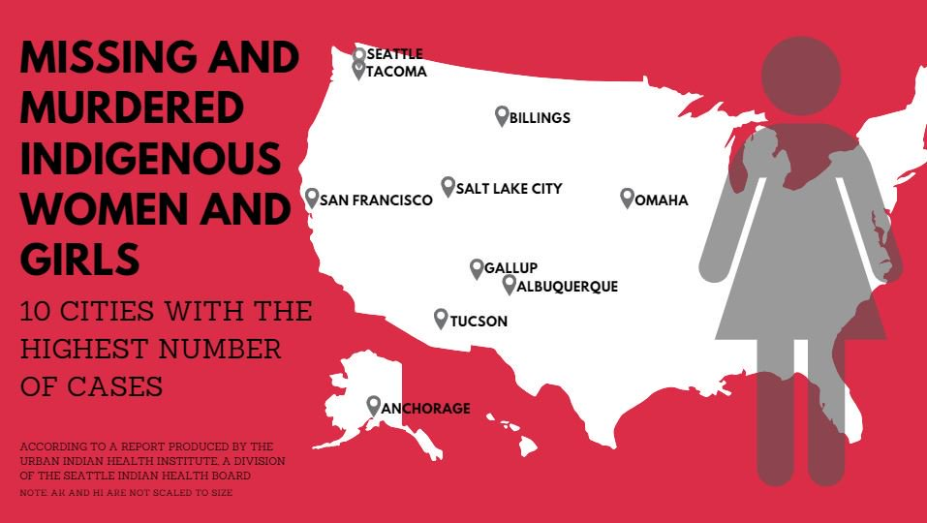
MMIW

Slide 24
HT related podcasts
1. The Imagination Podcasts with Emma on Youtube, Rumble = web @ www.standbysurvivors.com
2. Anneke Lucas Podcasts = Advocate for Child Sex Trafficking & SRA victims, starting speaking out in 2013, TED talks, website @ www.annekelucas.com
3. Only God Rescued Me Podcasts = Lisa Meister podcasts on Rumble web @ www.onlygodrescuedme.com
4. Gabbi Choong Podcasts = Rumble podcasts Australia Intergenerational human trafficking, Child sexual abuse, Ritual abuse, Satanic Ritual Abuse SRA survivor website @ www.truthjusticefreedomforchildren.com
5. Carmen Studer Podcasts = Carmen Studer = Dallas area interviewer on Youtube with HT topics & guests @ www.carmenstuder.com
6. Edge of Wonder Ben & Rob do shows on many interesting topics @ www.rise.tv & www.EdgeOfWonder.tv

Slide 25
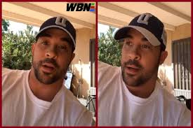
More HT related podcasts
7. Kerry Cassidy = investigative truth seeking journalist website @ www.ProjectCamelotPortal.com
8. David Nino Rodriguez = ex-pro heavyweight boxer whose video about human trafficking in Hollywood went viral & website @ www.ninoscorner.tv
9. Marisol Nichols = The Hollywood Vigilante, Podcast For a Slavery Free World on Youtube & website @ www.marisolnichols.com
10. Charlie Ward = The Charlie Ward Show talks about International Human Trafficking, Child auctions, Adrenochrome manufacture, organ harvesting & web @ www.drcharlieward.com & The Mel K show @ www.themelkshow.com
11. Ann Vandersteel = Steel News on Youtube & web @ www.vandersteel.com
12. Nicholas Veniamin = @ www.nicholasveniamin.com & www.NickV.tv & www.t.me/NicholasVeniamin & Bitchute
Others = Christie Hutcherson = CEO Women Fighting for America @ www.wffa.win & email at wffamediateam@protonmail.com
* 50 Voices of Ritual Abuse (2024) website @ www.50voices.org

Slide 26
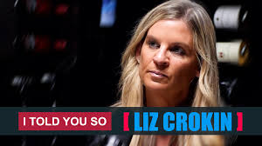
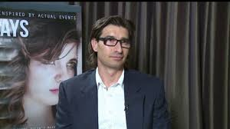
Liz Crokin & Jaco Booyens
Liz Crokin website @ www.lizcrokin.com
Slave Princess (2022) documentary – Liz Crokin -- “Slave Princess”—a “documentary” about Britney Spears' conservatorship issues made by Qultists to advance their agenda.
Out of Shadows (2020) documentary – Liz Crokin -- An exposé on how Hollywood and the mainstream media manipulate the multitudes by spreading propaganda throughout their content. Director Mike Smith
Jaco Booyens website @ www.jacobooyensministries.com
Sex Nation (2023) documentary by Jaco Booyens -- A Jaco Booyens Film about sex trafficking and our nation's Godless epidemic. Jaco recently produced and directed the documentary feature film SEX NATION, released in March 2023, targeting the root of the sexually immoral movement and culture in America. He weekly appears on local, national, and international television and radio shows, podcasts, and live streams.
8 Days (2014) movie – Jaco Booyens -- 8 Days: Directed by Jaco Booyens. With Nicole Smolen, Sebastian Aguilar, Cameron Allsup, Ivette Alvarez. After sneaking to a party with her friends, 16-year-old Amber Stevens goes missing. Forced into the world of sex trafficking, her family, and community fight to get her back. Inspired by actual real-life events.

Slide 27
Revelation Method, PP, CD, Willful Ignorance
*REVELATION OF THE METHOD = THE ELITES DO TELL US THROUGH THEIR BOOKS, PUBLICATIONS, MOVIES, MUSIC & NEWS RELEASES WHAT THEY ARE DOING – THIS IS CALLED REVELATION OF THE METHOD. FROM THEIR POINT OF VIEW IT IS YOUR PROBLEM IF YOU ARE TOO STUPID TO RECOGNIZE IT FOR WHAT IT IS. A FORM OF RITUAL MOCKING OF THE VICTIM.
Predictive Programming = shows what the Global Elite are planning to do in the future, free will to do or not.
COGNITIVE DISSONANCE = THIS IS WHY PEOPLE GET UPSET WHEN THEIR BELIEFS ARE CHALLENGED = A mental conflict occurs when beliefs are contradicted by new information. This content activates areas of the brain involved in personal identity and emotional response to threats. The brain’s alarms go off when a person feels threatened on a deeply personal and emotional level, causing them to shut down and disregard any rational evidence that contradicts what they previously regarded as “truth.”
*Willful Ignorance = not knowing the truth (ignorance is hell, MSM brainwashed) &/or not wanting to know the truth (cognitive dissonance)! Denial of reality despite the facts, evidence, truth. Truth makes sense & lies don’t make sense. A bad faith decision to avoid becoming informed about something so as to avoid having to make undesirable decisions that such info might prompt…Willful ignorance is the state and practice of ignoring any sensory input that appears to contradict one’s inner model of reality (driven by confirmation bias).
*Currently, there are over 1 million Satanists operating in the USA so the internal threat is greater than the outer threat. –Ben Fulford on The Mel K Show 9/25/22

Slide 28
Top 10 Human Trafficking HT movies of all time:
1 Eastern Promises (2007) = Naomi Watts @ Russian mafia in HT
2 Taken (2008) = Liam Neeson - The hostage at 96 hours, kidnapping, abduction
3 Trade (2007) = Kevin Cline from STL, MO - When HT hits home
4 Mardaani (2014) = movie about HT in India
5 The Whistleblower (2012) = Rachel Weisz @ HT in Eastern Europe
6 Sold (2012) = Journalist in HT ring while investigating illegal immigrants in America
7 Las Elegidas (2015) = “The Chosen” @ HT in Mexico
8 The Jammed (2007) = HT movie @ Labor trafficking & Organ harvesting
9 Eden (2012) = Beau Bridges @ HT in Texas
10 Spartan (2004) = Val Kilmer, Ed O’Neil

Slide 29
Top Movies, Documentaries, Songs, & Books on HT:
1) *Sound of Freedom (2019-2023) Jim Caviezel, Tim Ballard, Operation Underground Railroad (SLC, UT father of many kids, child HT rescuer).
2) *Devil in Ohio (September 2, 2022) = Netflix series on Satanism, Satanic Rituals, SRA (abuse, torture, sex magic) based on a true story. Trailer @ https://www.youtube.com/watch?v=ScEl_smzT3A
3) Girl in Room 13 (2022) film by Anne Heche - “Girl in Room 13” is still set to debut in September 2022 on the Lifetime network.
4) A Child’s Voice (2018) John Paul Rice Hollywood film producer for 20 years, on No Restrictions Entertainment & Vimeo on demand @ www.vimeo.com Save the children, # End human trafficking, & Love will win!
5) Priceless (2017) Joel Smallbone, Bianca Santos, Amber Midthunder, Jim Parrack, David Koechner Director Ben Smallbone
6) Border Town (2006) Jennifer Lopez, Antonio Banderas, Martin Sheen movie about Human (Labor) Trafficking in Juarez, Mexico

Slide 30
Top Docs/Websites Human Trafficking HT topics:
1. *50 Voices of Ritual Abuse (2024) website @ www.50voices.org
2. *Cages (2023) Documentary about HT on Rumble by Louis Herms
3. The Greatest Show on Earth (2023) by Nick Alvear
4. ISIS Sex Slaves (2023)& 26 Seconds (2019) trailer at www.26secondsdoc.com – Documentary by Kelly Galindo
5. *Am I Crazy?: My Journey to determine if my memories are true (2022) Documentary by SRA survivor Mary Knight
6. These Little Ones (2022) airing August 1, 2022 documentary by Stew Peters at www.stewpeters.com & TLO Part 2 = September 2022
7. *Best Kept Secret (2021) Documentary (2:47) by Sean Stone (son of Oliver) www.SeanStone.info & www.107daily.com on Vimeo & A Thousand Pieces (2020) – Sean Stone @ www.athousandpieces.com 2020 Documentary
8. Pervywood 1-12 (2021) by Nick Alvear, Red Pill Media & Good Lion Films, Bitchute, Nick Alvear Talks About Pervywood,... The Sequel to the Fall of the Cabal #1-22 @ www.goodlion.tv

Slide 31
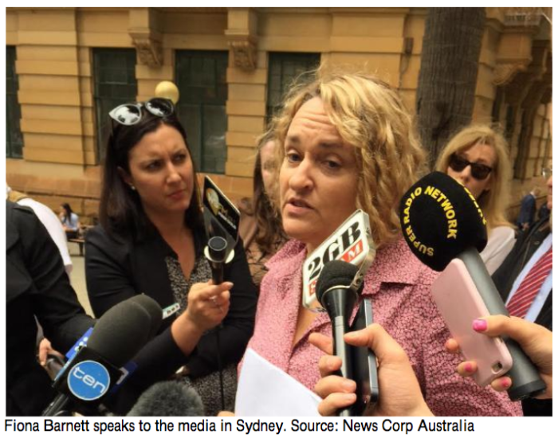
Fiona Barnett = Australia
9. *The “Candy Girl” (2015) Documentary SRA in Australia & Book Eyes Wide Open (2020) Lockdown Edition by Fiona Barnett & website @ www.fionabarnett.org & @ www.pedophilesdownunder.com
10. *Fall of the Cabal (2020) Documentary by Janet Ossebaard
11. Marc Dutroux – the Beast from Belgium (2017) Documentary about the Dutroux case
12. Who Took Johnny (2014) Documentary about Johnny Gosch
13. Conspiracy of Silence (1993) Documentary about the Franklin scandal by Neal Marshad & Donna Olson
14. *60 Minutes Australia – Satan’s Children (1989) TV show on the case of Teresa on the topic of ritual abuse by John Pellington
15. Others = David Icke books, David Wilcock videos

Slide 32
Survivor Truth, Listen with Respect, Support
Individual’s who escape abuse and torture deserve the utmost respect and support. These people have risked it all to heal and stand up for the truth. These people are heroes and angels who hold a horrific reality for everyone else. They suffered and escaped, and for that, we should bow our head in reverence and listen to their stories.
Make no mistake. Survivors are NOT weak or vulnerable. No. Not that. What survivors ACTUALLY are, are the most incredible, brilliant, and powerful humans walking the planet. They are f*cking WARRIORS. They survived every attempt that could possibly be made on a person to break and destroy them over a lifetime. They’ve lived 100 lives while the rest of us live one. Survivors are real life super heroes. They are the ones who have been anointed to save and change the world. They are the ones we’ve been waiting for. Mark my words. –Emma, The Imagination Podcast 2023
Rather than love, than money, than faith, than fame, than fairness “give me Truth.” -Thoreau

Slide 33
SRA = Jeanette Archer, England Royal family
Satanic Ritual Abuse (SRA) = is a worldwide phenomenon that also exists in Australia. It involves “elite” pedophile rings, the sex trafficking of children and the highly profitable production of adrenochrome, child pornography, & child snuff films. Jeanette Archer from England is exposing these crimes. She witnessed first hand, the sexual abuse and murder of children at Windsor Castle. High profile names are being revealed, including members of the Royal family and Freemasons who are involved in the systematic sexual abuse of children. The Freemasons are a shopfront for SRA. Jeanette Archer was raised in an intergenerational Satanic cult family. She was sex trafficked and sold by her own father from the age of 3 to Satanic pedophile rings that included members of the Royal family. Jeanette was frequently tortured and raped between the ages of 3 to 9 years old. She was driven by car from her family home and trafficked to Windsor Castle by Satanic police and high profile men, who would be the first to rape her. She was exceptional in that she was tagged at “human hunting parties” to remain alive during these events.

Slide 34

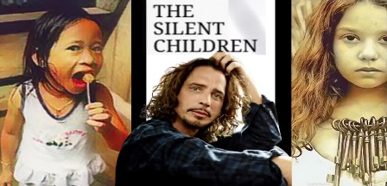
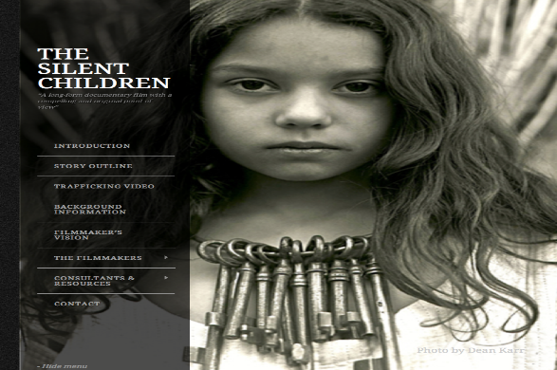
HT Related Music & Music Videos:
*For a Better Day (2015) by Avicii or Tim Bergling watch Music video about child sex trafficking, child auctions, child sex slavery
Run Away Train (1993) by Soul Asylum song about 36 missing children & 26 children were found after being featured in the video according to sources
*Hunger Strike (1992) by Temple of the Dog song about SRA Satanic Ritual Abuse, Cannibalism sung by Chris Cornell & Eddie Vedder from Seattle Bands (Read the lyrics a few times until you get the meaning)
*Play Me Backwards (1992) by Joan Baez song about SRA Satanic Ritual Abuse, Ritual Abuse
When the Children Cry (1987) by White Lion song about child abandonment, child abuse, single parent and fatherless homes
Hell is for Children (1980) by Pat Benetar song about child abuse
Others = Sympathy for Devil, Mask of Great Deceiver, ‘El Diablo’

Slide 35
Best Books on Human Trafficking HT (2000-2025):
Moscow Traffic: An International Thriller (2023) by Juliette Engel
Angels Over Moscow: Life, Death, and Human Trafficking in Russia – A Memoir (2021) by Juliette Engel
Sparky: Surviving Sex Magick (2020) by Juliette M. Engel, MD
Ending Human Trafficking: A Handbook of Strategies for the Church Today (2022) by Shayne Moore, Sandra Morgan, Kimberly McOwen Yim
Human Trafficking: A Comprehensive Exploration of Modern Day Slavery (2020) by Wendy Stickle, Shelby Hickman, Christine White
Red Haze: A Human Trafficking Survival Thriller (2020) by Scott Smith
Invading the Darkness: Inside the Historic Fight Against Child Sex Trafficking in the United States (2019) by Linda Smith
Ending Human Trafficking & Modern-Day Slavery (2018) by Annalisa Enrile
Human Trafficking 101: Stories, Stats, Solutions (2018) by Amy Joy

Slide 36
More Best HT Books
*Sex Trafficking: Inside the Business of Modern Slavery (2017) by Siddharth Kara
In Our Backyard: Human Trafficking in America and What We Can Do to Stop It (2015) by Nita Belles
The White Umbrella: Walking with Survivors of Sex Trafficking (2012) by Mary Frances Bowley & Louie Giglio
Girls Like Us: Fighting for a World Where Girls Are Not for Sale: A Memoir (2012) by Rachel Lloyd
*Not for Sale: The Return of the Global Slave Trade & How We Can Fight It (2010) by David Batstone
The Slave Across the Street (2010) by Theresa L. Flores
Renting Lacy: A Story Of America's Prostituted Children (2009) by Linda Smith
*Dope Inc.: Britain’s Opium War Against the United States (1978) by Konstandinos Kalimtgis

Slide 37
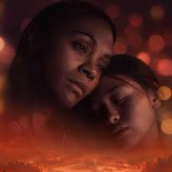
Newer to Older HT Movies:
*Turned Out: The Movie (September 17, 2024) =
Escape (2024) =
*City of Dreams (August 2024) = LA labor trafficking
*The Absence of Eden (2024) = Zoe Saldana
Maya (2023) =
Trafficking (2023) =
Don’t Say My Name (2023) =
Paradise Highway (2022) =
I See You (2019) =
*Hard Core (1979) = George C Scott

Slide 38
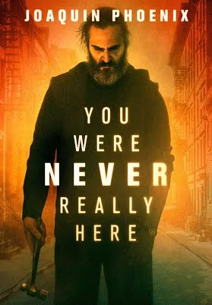
Top 5+ Movies related to Pedophilia & Elite Pedophile Networks:
1 Cult Killer (2024) = movie about elites crimes with Antonio Banderas
2 *You Were Never Really Here (2018) Movie & Book Joaquin Phoenix rescues HT victims from Wealthy Elite networks in the USA
3 Sex Doll (2017) London’s underground HT/pedophile networks & Elite’s sex trade rescues.
4 *Spotlight (2015) = Michael Keaton @ 250 pedophile priest abused over 1000 kids in Boston, US, & around the World
5 *Starry Eyes* (2014) = Starry Eyes is a 2014 American horror film directed and written by Kevin Kölsch and Dennis Widmyer.
6 *An Open Secret (2014) = Movie on Vimeo about Pedophiles in Hollywood
7 Deliver Us From Evil (2006) = Movie about Pedophiles in the Roman Catholic Church and how it affects the victims lives – The Keepers, The Finders = (Child abductors)
8 Sleepers (1996) = Brad Pitt, Kevin Bacon, Jason Patric, Minnie Driver, Dustin Hoffman, Robert DeNiro

Slide 39
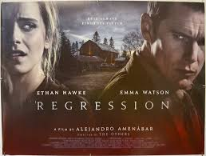
Ritual/Cult Abuse, SRA = Satanic Ritual Abuse
1 God is a Bullet (2023) movie about satanic cults with Jamie Foxx - The film follows detective Bob Hightower, who finds his ex-wife murdered and his teenage daughter kidnapped by an insidious satanic cult.
2 Satanic Panic (2019) movie @ A pizza delivery driver finds herself in a fight for her life when she delivers an order to a group of Satanists looking for someone to sacrifice.
3 Midsommar (2019) = A couple travels to Northern Europe to visit a rural hometown's fabled Swedish mid-summer festival which quickly devolves into an increasingly violent and bizarre competition at the hands of a pagan cult.
4 *The Institute (2017) The Institute is a 2017 American horror thriller film co-directed by Pamela Romanowsky and James Franco. It is based on a true story of a young girl's SRA treatment at The Rosewood Institute in Owings Mills, Maryland, and stars Franco, Allie Gallerani, Tim Blake Nelson, and Lori Singer.
5 *Regression (2016) Emma Watson, Ethan Hawke – Movie about Satanic Ritual Abuse, Satanic Rituals & Child Sacrifice at farm in a Minnesota small town. A detective and a psychoanalyst uncover evidence of a satanic cult while investigating a young woman's terrifying past.
6 *Eyes Wide Shut (1999) Eyes Wide Shut is a 1999 erotic psychological mystery drama film about elite Satanic rituals directed, produced and co-written by Stanley Kubrick.
7 Satanic Panic (2006) movie filmed in Rochelle & Elizabeth, Illinois @ Six friends decide to take a canoe trip but find themselves in hell once a group of Satanists move in for the kill.
8 *Race with the Devil (1975) Peter Fonda, Warren Oats, Loretta Swift, Lara Parker star in this high-octane horror-thriller about 2 couples who encounter a vicious, murderous Satanic cult while on vacation in Texas

Slide 40
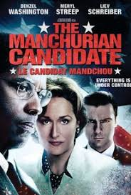
Movies about Mind Control
*The Manchurian Candidate (2004, 1962) The Manchurian Candidate is a 1962 American neo-noir psychological political thriller film about MK Ultra mind control directed and produced by John Frankenheimer. & The Manchurian Candidate is a 2004 American neo-noir psychological political thriller film about MK Ultra mind control - Denzel Washington, Meryl Streep, directed by Jonathan Demme.
Jason Bourne (2016) Matt Damon about MK Ultra Mind Control Programming
*American Ultra (2015) Jessie Eisenberg, Kristen Stewart - Mike Howell was trained by the CIA to be a lethal killing machine. The Bourne Legacy (2012) Matt Damon about MK Ultra Mind Programming
*The Men Who State at Goats (2009) George Clooney, Jeff Bridges, Ewan McGreggor movie about MK Ultra Mind control, Remote viewing, Psychic assassins
The Bourne Ultimatum (2007) Matt Damon about MK Ultra Mind Control Programming
The Bourne Supremacy (2004) Matt Damon about MK Ultra Mind Control Programming
The Bourne Identity (2002) Matt Damon movie about MK Ultra Mind Programming of Elite Government Agent Jason Bourne from Nixa, MO
*The Sleep Room: The CIA & MK Ultra in Canada (2006) DVD/Video Nicola Cavendish, Eric Peterson
Conspiracy Theory (1997) = Mel Gibson, Julia Roberts – Mel Gibson stars as a paranoid taxi driver who constantly reveals his crazy (mostly true) conspiracy (truths, realities) theories to skeptical Justice Department attorney Julia Roberts.
*Timebomb (1991) Most realistic movie on mind control – Michael Biehn (The Terminator, Aliens) and Patsy Kensit (Lethal Weapon 2, Absolute Beginners) star in the pulse-pounding action thriller, Timebomb.

Slide 41
Kerth Barker Quotes
“Many people in our world simply do not want to know about things that are too frightening. The world is in peril not because of the people who do evil, but because of the good people who refuse to confront the existence of evil.”
“The ultimate goal of the High-Adept Satanists is the complete destruction of the human race and the natural ecosystem of Earth. They pursue this goal because they no longer identify themselves with humanity.”
“Globalist, plutocratic Satanism is behind virtually every major problem in this troubled world. You stand a better chance of surviving these difficult times if you understand the true nature of Satanism. And this is true no matter what your belief system.”
“The Illuminati strategy demands that the Illuminati remain invisible until which time it has complete control over the world.” (read Agenda 21, 2030)
“The more you understand how the human mind works, the more empowered you become.”

Slide 42
Kerth Barker = Midwest Mind control & SRA Cult survivor
If you’re getting flack…You’re over the target!:)
*“Conspiracy litmus test: if people have died trying to expose it, it’s real.” -Jordan Sather
Psychic Development: For Prosperity, Self-Defense, & Political Influence (2020) by Kerth Barker
*Mental Liberation in the Age of Thought Control: Deprogramming Satanic Ritual Abuse, MK Ultra, Monarch & Illuminati Mind Control (2020) by Kerth Barker
Cannibalism, Blood Drinking, & High-Adept Satanism (2019) by Kerth Barker
Angelic Defenders & Demonic Abusers: Memoirs of a Satanic Ritual Abuse Survivor (2019) by Kerth Barker
*Overcoming Monarch Mind Control: Feedback from Therapist & Survivors (2019) by Kerth Barker
Deconstructing the Illuminati: What the Illuminati Really Is & How to Defeat It (2017) by Kerth Barker

Slide 43
Kerth Barker Quotes
“So you need to understand that blood drinking isn’t just a rare phenomenon. What I am telling you now is not a fantasy story. This is not a myth. This is not an urban legend. This is what is really going on in the real world now. Well-organized cult members systematically abduct people, torture them to adrenalize their blood, harvest that blood and then drink it. And some of these cult members are addicted to drinking adrenalized human blood in the same way that cocaine addicts are addicted to cocaine.”
“Whether you are Christian, Luciferian, atheist or any other philosophy, your survival and the survival of your family depends upon the defeat of the High-Adept Satanists. And this is achieved by learning the truth and teaching it to others.”
“The most powerful members of the Illuminati are from inbred generational billionaire families. They don’t care about you and your family. They are beyond sociopathy. They are megalomaniacal psychopaths. They may talk about creating a Utopian global government once they are all powerful, but they have no intention of doing that.” (see Protocols of Zion Map = Dylan Louis Monroe)

Slide 44
Illuminati Mind Control = Marcel Polte, Russ Dizdar
Uncle Sam’s: An Insider’s Report from the Hell of Monarch Mind Control (2023) by Dr. Marcel Polte
Dark New World Order Part 2 (2021) by Dr. Marcel Polte
Dark New World Order Part 1 (2019) by Dr. Marcel Polte
Liberty Crusade: The Fight to Save the Free World (2021) by Larry Ballard
Eaters of Children The Pedocracy Exposed: How access to power is granted through the rape, torture, & ritualistic slaughter of the innocent (2017) by Johnny Cirucci
*The Black Awakening: Rise of the satanic super soldiers and coming chaos (2024, 2009) by Russ Dizdar = researcher, SRA author, Occult crime, Luciferian agenda, super soldiers
Expelling Darkness: Engaging Non-Human Entities Now and In the End of Days (2017) by Russ Dizdar
*How the Illuminati Create An Undetectable Total Mind Controlled Slave (2008) by Fritz Springmeier & Cisco Wheeler
*Bloodlines of the Illuminati (2005) by Fritz Springmeier

Slide 45
Joachim Hagopian = child advocacy, human rights
Pedophilia & Empire: Satan, Sodomy & the Deep State Book 1: A Quarter Million Millenia of Human Enslavement, Child Rape, and Blood Sacrifice from Antiquity to the Modern Catholic Church (2020) by Joachim Hagopian
Pedophilia & Empire: Satan, Sodomy, and the Deep State Book 2: The United Kingdom – The World’s Pedophilia Epicenter (2020) by Joachim Hagopian
Pedophilia & Empire: Satan, Sodomy, and the Deep State Book 3: The Rothschild Illuminati Bloodline and Ties to More British Scandals (2020) by Joachim Hagopian
Pedophilia & Empire: Satan, Sodomy, and the Deep State Book 4: North America’s Shameful Pedophilia Scandals Like Never Before (2021) by Joachim Hagopian
Pedophilia & Empire: Satan, Sodomy, and the Deep State Book 5: The Pedophilia Scourge Spreads to the Rest of the World (2021) by Joachim Hagopian =
5-book volume series entitled books and chapters are Amazon bestsellers in child (safety) advocacy and human rights categories.

Slide 46
Svali speaks = ex-chief programmer of Jesuits based in Rome
Never Give Up Part 2: The Struggle - Autobiography of a Survivor of Ritual Abuse and Mind Control (2024) by Svali
Never Give Up: The Autobiography of a Survivor of Ritual Abuse and Mind Control (2024) by Svali
The Svali Chronicles – Breaking free of mind control: Testimony of an ex-illuminati (2023) by Svali
A Day in the Life of a Trainer (2001) by Svali
The End of the Illuminati (2001) by Svali
It’s not Impossible: Healing from Ritual Abuse & Mind Control (2018) by Svali
Svali Speaks – Breaking free of cult programming (2016) by Svali
Svali speaks again blog @ www.slavispeaksagain.wordpress.com
Svali speaks blog @ www.slavispeaks.wordpress.com

Slide 47
Elisa E, Jon Wedger, Chantal Frei
Our Life Beyond MKUltra: Then & Now (2022) by Elisa E
Our Life Beyond MKULTRA: Book 2 (2013) by Elisa E = MK Ultra survivor, author
Our Life Beyond MKULTRA: Book 1 (2013) by Elisa E
The Great Reveal: Featuring Jon Wedger Ex-Scotland Yard Detective Exposes Child Trafficking & Satanic Ritual Abuse Going to the Top (2023) by Jon Wedger, John Cooper
Katy: world’s torn apart (2023) by Rodjanha Svagorik
Project MK Ultra: The History of the CIA’s Controversial Experimentation Program (2022) by Charles River Editors
SPEAKING OUT!: My Life under and Escape from Satanic Ritual Abuse (2022) by Chantal Frei = grew up in Swiss cult Satanic family & had to carry out military orders abroad
Surviving the Occult: Little Bird and her Jesus (2021) by Robyn Kranig
Take Courage (2019) by Allie Harrison

Slide 48
Wendy Hoffman = MK Ultra & cult survivor from a Jewish Illuminati family
*A Brain of My Own: A memoir about dissociation dissolved (2020) by Wendy Hoffman
*The Enslaved Queen: A Memoir about Electricity & Mind Control (2019) by Wendy Hoffman
*White Witch in a Black Robe: A True Story about Criminal Mind Control (2019) by Wendy Hoffman
Finding Freedom: Helping Survivors of Ritual Abuse and Mind Control to Heal Back (2020) by CARE Inc, Jo Gerzinger, CARE staff
Prayer Warrior 2: Prayers for Healing from Ritual Abuse and Mind Control (2019) by CARE Inc
Dealing with Curses and Generational Inequities: Releasing People, Communities & Nations into God’s Blessing (2018) by Selwyn Stevens Ph.D.
*Snatched from the Flames: One man’s journey to uncover The Family Secrets buried in his blood-stained past (2018) by Nathan Reynolds
*What Witches Don’t Want Christians to Know Expanded Edition: A True Story of the Occult and Mind Control (2014) by Mary Lou Lake
Freedom Coming Out From Under The Curses of Freemasonry (2014) by Grant & Samantha Mahoney
*He Came to Set the Captives Free (1986) by Rebecca Brown, MD

Slide 49
Allison Miller = Clinical psychologist, Victoria, BC
From the Trenches: A Victim and Therapist Talk about Mind Control and Ritual Abuse (2017) by Wendy Hoffman & Dr. Alison Miller
Becoming Yourself: Overcoming Mind Control and Ritual Abuse (2014) by Dr. Alison Miller = dev. protocol for effective treatment for Dissociative Disorder, RA, Mind Control
Healing the Unimaginable: Treating Ritual Abuse and Mind Control (2012) by Dr. Alison Miller
Prayers of Protection (Amanda Buys has Great Prayers on her website) = Amanda Buys & Roly Buys Prayers website @ www.kanaanministries.com
*Dangerous Prayers from The Courts of Heaven that Destroy Evil Altars (2021) by Dr. Francis Myles
Prayer Warriors: A Prayer Book for Survivors of Severe Trauma and Those Who Care for Them (2021) by Jo Gerzinger, Sara Mannaseh
Extreme Prayers That Shake Heaven and Earth (2021) by Daniel Duval
Advanced Prayers That Shake Heaven and Earth (2019) by Daniel Duval
Prayers That Shake Heaven and Earth (2018) by Daniel Duval

Slide 50
Expert Literature on Ritual Abuse: Books written/edited by Therapists:
Alison Miller
James Randall Noblitt
Colin A. Ross
Joseph Schwartz
German Experts = Michaela Huber
Claudia Flib
Claudia Igney
Gaby Breitenbach
Brigitte Hahn
Journal of Trauma & Dissociation
Trauma & Gewalt = German journal
www.traumadissociation.com/alters = Excellent info on DID & different alters can be found here at this website.
*“Either we will start using our spiritual and psychic powers to defend ourselves – or the human race will be destroyed.” -Kerth Barker

Slide 51
AESSA = Awareness, Education, Solutions, Service, Advocacy
“Have a mind that is open to everything and attached to nothing!” –Patanjali, Dr. Wayne Dyer
*TRUE WARRIORS CONFRONT THE EVILS OF SOCIETY THAT MOST PEOPLE REFUSE TO EVEN ADMIT EXIST.
* HT Awareness = Create awareness about modern day slavery evil in USA & @ the world
* HT Education = Education about human trafficking & topics related to HT
* HT Solutions = Be part of the solution not denial of the problem (willful ignorance, cognitive dissonance)!
* HT Service = Jesus Agape Love & Service to others (Victors, Survivors, Overcomers, Warriors for Truth, Peace, & Freedom)
* HT Advocacy = Advocate for the innocent, vulnerable children, victims, victors, overcomers, survivors of HT
*“The Truth is like a Lion. You don’t have to defend it, just let it loose, & it’s gonna defend itself!” -St. Augustine
“Reality cannot be ignored except at a price; and the longer the ignorance is persisted in, the higher and more terrible becomes the price that must be paid.” -Aldous Huxley

Slide 52
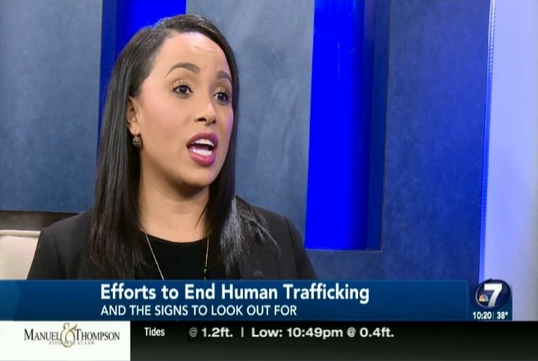
Sula Skiles: HT sex trafficking survivor story = Freedom
*Get connected with local non-profit organizations that are working in human trafficking
*Show up to events that are about sex trafficking
*Read everything that you can on the topic and use your voice
*Do social media to spread awareness so their friends know
*Parents definitely be aware & make sure you take the initiative to talk to your kids & talk to your teenagers about what is going on
*If I would have known absolutely that this existed, I know in my heart I would have made different decisions
*Awareness is so powerful and as overwhelming & traumatic as sex trafficking is, it’s important to know how it affects us here as Americans and it’s not just something that is overseas
*The importance of being aware and sharing with our friends and family

Slide 53
Human Trafficking HT Solutions = What can you do?
1. Talk about it = it’s not just an international issue, it’s a domestic issue as well! Growing Awareness
2. Put pressure on public officials to change laws. Change laws for trafficking victims who were forced to break laws.
3. Change the culture = Good guys don’t go to strip clubs, there is a relationship between sex businesses = pornography, strip clubs, massage parlors, brothels, street / internet prostitution, snuff films, & human trafficking. It’s all part of the web of HT.
4. Stop watching pornography = directly fuels human trafficking, young generation is porn addicted. Supply and demand that involves sexually exploiting more people!
5. Punish clients & traffickers = criminalize men buying sex.
6. Empower women = sexual assault, trafficking, standing up for yourself, raise strong girls who stand up for themselves and see their worth as women within themselves & not given to them from others.
7. Join Awareness Groups = HT tours in your town (Houston, Dallas, Atlanta, Charlotte)
8. Volunteer = Go out & serve, that is the best experience (Nightlight)!
9. Use Area of Influence = Blogger, Teacher, Musician, Doctor = perfect voice to help HT

Slide 54
HT suggestions to get involved, take massive action!
10. Incorporate HT info into your conferences, trainings, & other informational materials.
11. Join or start a grassroots anti-trafficking coalition.
12. Meet with local, state, and federal government representatives; ask what they are doing in your community.
13. Volunteer in clinics, emergency departments, & out-patient departments to provide screening.
14. Donate funds or needed items; check out HT (TAT, AU, Polaris Project) websites.
15. Organize a fundraiser for organizations that are helping victims & survivors.
16. Raise awareness by viewing & showing one of many HT videos (Tricked, Hot Girls Wanted).
17. Speak at a school to alert students and advice parents/teachers that their children are at risk.
18. Purchase items made by Fair Girls or Made by Survivors.
19. Invite your staff to attend free training at your hospital or clinic by local community centers or email info@healthcareagainsttrafficking.com

Slide 55
Top 5-10+ Human Trafficking HT USA Organizations:
1 *Jaco Booyens Ministries, Arlington, Texas – Epidemic of Sex Trafficking. The U.S. has an estimated 500,000 victims in the U.S. trafficking rotation & only 1% of the crime is reported. There are 582 total licensed beds in the U.S., & only 200 of those serve minors. Contact @ www.jacobooyensministries.org
2 *Ambassadors United = Rescuing Souls and Ending Human Trafficking in Greater Houston, HT Education, Online Course, Real Life Practicum in Houston, Texas @ www.ambassadorsunited.org & email @ www.iwantfreedom@outlook.com
3 The Ruby Organization = Improving the lives & well-being of adult women who are victims of human sex trafficking. Ruby a non-profit organization is located in Cabarrus County, Concord, Charlotte, North Carolina. Volunteer orientation & training at outreach@therubyorg.org & Tracy Minchin, Ruby Director email at director@therubyorg.org & Contact at The Ruby Organization PO Box 6101 Concord, NC 28027 phone 704-970-RUBY (7829) Help Line at 980-250-5017
4 *Truckers Against Trafficking = Watch the complete Truckers Against Trafficking Training Video Below (full length version) @ www.truckersagainsttrafficking.org
5 Tim Ballard, Operation Underground Railroad (SLC, UT) Operation Underground Railroad is a United States-based nonprofit organization involved in the rescue of human trafficking and sex trafficking victims, with a special focus on children, and a wider goal of eliminating sex trafficking world-wide. @ www.ourrescue.org

Slide 56
Top 5-10+ Human Trafficking HT USA Organizations:
6 A21.org = A21 OUR MISSION IS TO END SLAVERY But we can't do it without you. Join us for a global event to unpack the reality of human trafficking and how you can be part of the solution to end it. . . Register Now HUMAN TRAFFICKING Human Trafficking is the abuse of children, women, and men for their bodies and labor. @ www.a21.org
7 27 Million.com = We stand alongside grassroots organizations around the world who are on the front lines as they battle to end slavery. We offer support and training to these organizations, as well as create projects and opportunities so that everyone can make a stand in solidarity with modern-day slaves. @ www.27million.com
8 Love146 = Love146's ending child trafficking and child exploitation prevention curriculum. Not a Number is an interactive child trafficking and exploitation prevention curriculum designed to provide youth with information and skills in a manner that inspires them to make safe choices. @ www.love146.org
9 *Rescue 1 Global's R1G = Fighting Human Trafficking on a Global Scale and provide holistic restoration: at home and around the world. Rescue 1 Global is a 21st Century Abolitionist Movement located in Tennessee combating human trafficking on a global scale by serving communities around the world until they are free from slavery & SRA. –Corrine Cline, Website @ www.rescue1global.org
10 Airline Ambassadors International (AAI) = Nancy Rivard, Founder & President of Airline Ambassadors International (AAI) 866-Angel-86 or 866-264-3586 helps vulnerable children around the world. AAI is a non-profit organization that partners with the airline industry to provide training to airline and airport personnel, supporting many humanitarian causes. Recognized by both the US Congress and the UN, AAI has personally distributed more than $60 million in aid to children & families in 62 different countries. Website @ www.airlineamb.org AAI 550 14th Road South #1014 Arlington, VA 22202 - Marisol Nichols, For a Slavery Free World Interview

Slide 57
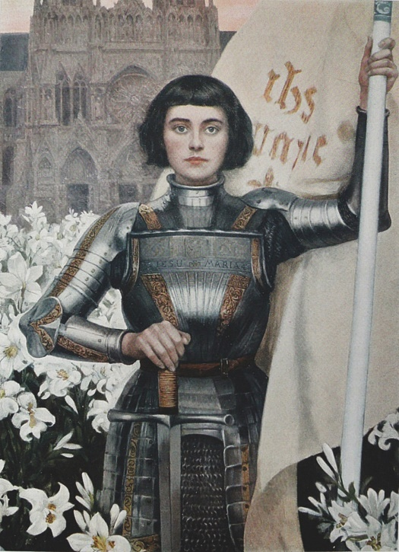
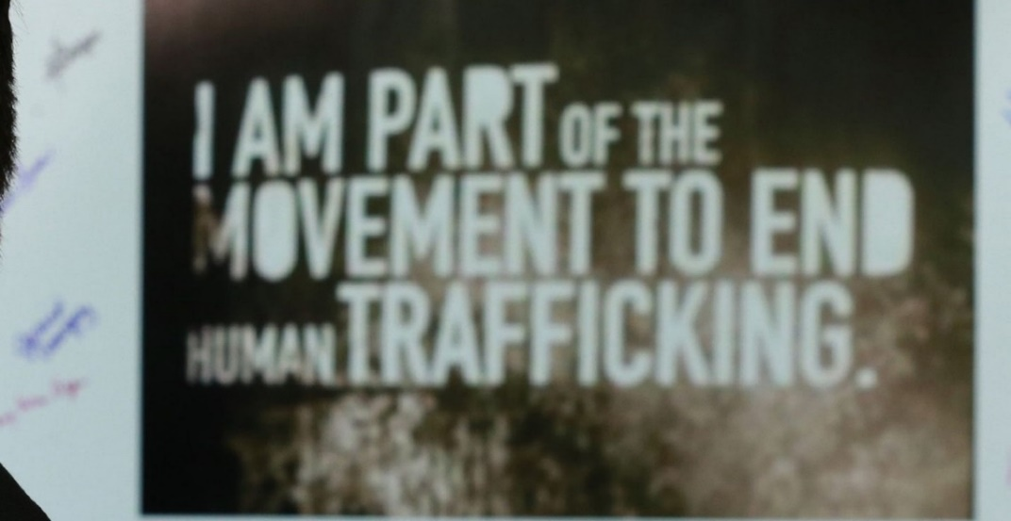
Warrior Spirit = HT ends with me!
HT ends with ME & You! If you want change, do something about it…The small action might lead to a big impact. You never know? -Leon Lee, Human Harvest
Warrior Spirit
*“I’M NOT AFRAID. I WAS BORN TO DO THIS.” -Joan of Arc
Make No Mistake
I will defend the weak (innocent children)
I will defend freedom
I will sacrifice so that others may live free.
I will defend my family to the death.
I love peace, but I am a fierce enemy.
I live by a special code.
I live with honor!
I was born to be the…WARRIOR!

Slide 58
Final Thoughts
“The secret of secret societies is that they hurt kids (for power, fame, & money) and drink their blood which is Adrenochrome.” –Courtney A. Walsh
“drinking human blood is morally wrong. I strongly believe that people shouldn’t do it. Human lives are taken in doing this. People are missed by their loved ones. I feel sad and disturbed when I think of all the parents who have lost a beloved child and spent years wondering what has happened to him or her. This harvesting of human blood must stop.” ― Kerth Barker
“High-Adept Satanists are obsessed with demons. They perform ceremonial rituals in which they connect their minds with the minds of demons. The High-Adept Satanists come to deny their humanity. They identify themselves with the demons and come to see the human race as their enemy. And they do everything in their power to further a plan to destroy humanity. The High-Adept Satanists use their psychic powers to create great wealth for themselves. They represent themselves to humanity as wealthy aristocrats. The High-Adept Satanists control secret societies of criminal enforcers. These criminal enforcers sometimes practice blood drinking and cannibalism. And these violent enforcers put down any tangible threat to the High-Adept Satanists.”― Kerth Barker

Slide 59
Last Final Thoughts
“They honed a very sharp weapon and now it is pointed at them!” – Carrie Olaje, SRA survivor
“Many people are ignorant to that level of evil because it does not exist inside of them.” It’s true there are many people who don’t even know that this type of evil exist because it’s not part of their reality. - Chantelle Meyburgh
I really love your Christ, but I do not like your Christians for they are so unlike your Christ. -Gandhi
The Truth: A luciferian brotherhood cult has controlled the world for thousands of years and infected nearly every aspect of society. The Greater Truth: God cannot be stopped, Justice is coming, & God wins!
You will never understand how this world truly works until you research occultism, freemasonry and the people who actually run this world (global elites). Please pick up a book, turn on your computer, do some real research and stop calling everything a conspiracy. (see Agenda 21, 2030, 2050, Georgia Guidestones)

Slide 60
Agenda 21, 2030, 2050 & Georgia Guidestones GG
Agenda 21, 2030, 2050 = Depopulation Agenda = (pandemics, vaccines, AI, 5G,GMO)
GG = Maintain humanity under 500,000,000 in perpetual balance with nature.
Be not a cancer on the Earth (Top 1%) – Leave room for nature – Leave room for nature.
* Depopulation Agenda / Eugenics / Abortions
* Forced Immunizations, Rockefeller Medicine
* Artificial Intelligence A.I. / Transhumanism
* Cashless Society, Computer Chipping Humans
* 5G = Increased Cancers, Brain/Celluar Damage side effects
* Militarized Police State, 1 World (UN) Military Police
* GMO Food, Fluoride Water, Geoengineering, Solar Radiation Management (SRM), “Chemtrails”
* Hidden Technology = Cures for diseases, anti-aging med beds, Tesla free energy, Zero point energy, anti-gravitics
Child Kidnapping => Human Trafficking => Pedo-Satanism = Pedophilia => Satanism
*Others => Goal is 1 World Government, New World Order (NWO), Total Control & Worldly Power, Satanism

Slide 61
Alice Bailey 10 Point NWO Plan to Destroy Christianity
Alice Bailey 10 Point NWO Plan to Destroy Christianity: Currently displayed in the meditation room at the UN in New York City:
1 TAKE GOD AND PRAYER OUT OF THE EDUCATION SYSTEM
2 REDUCE PARENTAL AUTHORITY OVER THE CHILDREN
3 DESTROY THE JUDEO-CHRISTIAN FAMILY STRUCTURE OR THE TRADITIONAL CHRISTIAN FAMILY STRUCTURE
4 IF SEX IS FREE, THEN MAKE ABORTION LEGAL AND MAKE IT EASY
5 MAKE DIVORCE EASY AND LEGAL, FREE PEOPLE FROM THE CONCEPT OF MARRIAGE FOR LIFE
6 MAKE HOMOSEXUALITY AN ALTERNATIVE LIFESTYLE
7 DEBASE ART (ex. Pedophilia, Satanic), MAKE IT RUN MAD
8 USE MEDIA TO PROMOTE AND CHANGE MINDSETS
9 CREATE AN INTERFAITH MOVEMENT
10 GET GOVERNMENTS TO MAKE ALL THESE LAW AND GET THE CHURCH TO ENDORSE THESE CHANGES. -The Mel K show @ www.themelkshow.com

Slide 62
PROTOCOLS OF THE LEARNED ELDERS OF ZION (1897)
Notes from the First Zionist Congress (1897) in Basel, Switzerland Held by the World Zionist Organization (P1-24):
*Bring all governments under a Zionist Super-Government by means of bribery, deceit, treachery, and force.
*Exert influence through the Press / Media while remaining in the shadows. Each Jewish life is worth 1000 goyim (sheep).
*Engineer poverty and economic crisis. Direct the force of the mob against the aristocracy through Socialist, Anarchist, and Communist organizations.
Undermine all faiths. Replace the principle of the Godhead with algorithms and materialism.
*Dominate all sides of the public debate with contradictory opinions. Discourage proactive behavior & thought. Bewilder the goyim to such an extent as to cause them to abandon all opinions in political matters.
*Establish industry monopolies and raise the price of living necessities. Ruin the industry of the goyim and undermine their production capabilities.
*Militarize the police. Foment war with the neighboring countries of any nation that opposes our agenda.
*Fill the bureaucracies with obedient mercenary serfs trained in our special school. Maintain Jewish supremacy in the field of economic sciences.
*Create a Dictatorship, and rule by instilling terror in the goyim. Rig the tunnels under metropolises to explode, if the goyim ever rise up against us.
*Destroy the nuclear family. Introduce the poison of Liberalism. Replace the real rulers with a caricature of government, puppetted by us (Bush Sr. - Biden).
*Phase out all freedoms and rights slowly, while promising to give them back after the threats to civil order have been quelled. Vilify the concept of freedom.
*Control all public announcements, official state media, civilian news organizations, and even simulated opposition media outlets. Cover-up all criminal disobedience to us.
*Distract the public current of thought with endless news stories, amusements, games, pastimes, competitions in art, and sports of all kinds.

Slide 63
Dylan Louis Monroe @ www.deepstatemappingproject.com
*Abolish all religions other than Judaism. Degrade the prior, ousted governments. Espouse tranquility in serfdom to us, compared to torture & agitation under freedom.
*Control and lead all Masonic Lodges until our world government is established. Exile or execute all goy Masons by covert means, such as cancer. Out King will be in constant communication with the entire world (X).
*Rewrite the history taught in universities in our favor. Educate the goyim so that they become unthinking submissive brutes incapable of forming independent thoughts.
*Wreck the Christian priesthood and re-educate the youth. One third of our subjects will keep the rest under observation. Train the goy to spy and report on their neighbors.
*Create opposition groups to attract dissenters (sting operations). Arrest sedition-mongers at the first suspicion of insubordination to our ruler. The King of the Jews will be the real Pope of the Universe.
*Mercilessly prosecute political dissidents with inflated charges, like murder, insurrection, and all of the most abominable crimes = (treason, pedophilia, child torture & ritual murder, blood drinking, cannibalism).
*Bring goy states into bankruptcy through interest-bearing loans. Remove gold from circulation. In our new government, establish progressive taxes increasing in a percentage ratio to capital. No interest shall be paid by our new state, nor shall money remain stagnant…We will put an end to the abuses which we owe our mastery over the goyim, but which cannot be allowed in our (hunger games brave new world, 1984) kingdom.
Regarding Internal Loans: Replace money markets with government credit institutions. Bring all industrial undertakings into dependence on us.
*Gold holds the greatest power in the world, and God wills that we control it. All of our evil was to establish world peace, and peace will prevail if our laws are followed. Our authority will be glorious and all-powerful.
*Abolish luxury goods and alcohol consumption. Our king shall be the personification of power. The King of the Jews is chosen by God to topple all societies that resist us.
*We direct the education of thought for all humanity. Our King will come from the lineage of David. The Learned Elders will have the ultimate say in whether the King is fit to rule. -Dylan Louis Monroe @ www.deepstatemappingproject.com

Slide 64
Rockefeller Education System = Education or Indoctrination? Research: *Global Education 2000, Education 2000, America 2000, Global 2000 & Common Core, NCLB = No Child Left Behind
*Education 2000 = designed to increase our children’s learning capacity while destroying their ability to critically think for themselves. (Trance Formation of America: The True Story of a CIA Mind Control Slave (1995) by Cathy Obrien & Mark Phillips, p. 175) – Read books:
Educating for the New World Order by B.K. Eakman, published by Halcyon House ISBN#: 0-89420-278-2-3441000
A Critique of America 2000: An Educational Strategy by Kathy Simonds, published by Citizens for Excellence in Education
*The Deliberate Dumbing Down of America by Charolette Iserbyt, US Department of Education, Reagan administration (1980s)
Rockefeller Medicine Men: Medicine and Capitalism in America (2016) by E. Richard Brown
*The education system will be controlled and eventually destroyed by “Outcome Based Education” programs such as No Child Left Behind and Common Core. (Marrs, 2017, p. 318)

Slide 65
*Global Education 2000, Education 2000, America 2000, Global 2000 & Common Core, NCLB = No Child Left Behind
WHAT IF I TOLD YOU COMMON CORE WAS PURPOSELY DESIGNED TO BE CONFUSING & FRUSTRATING SO PARENTS WILL LOOK IGNORANT & CHILDREN WILL GET CONFUSED & FEEL STUPID BECAUSE UNEDUCATED KIDS WHO’VE BEEN PROGRAMMED TO DEPEND ON THE STATE FOR ANSWERS MAKE MUCH BETTER CONFORMIST DEBT SLAVES IN THE FUTURE
What are 4 words no teacher wants to hear? = No Child Left Behind => Deliberate Dumbing Down of America
What are 2 words no teacher wants to hear? = Common Core or Standardized Testing
What is 1 word no teacher wants to hear? = Assessment or Analysis = Too much Assessment is Assinine & Dumbs Down Kids while Analysis is Anal, Lowers Performance (Choking =Analysis Paralysis or Paralysis by Analysis) Leads to Boredom, Apathy, & Ultimately Failure by Design!
*Formal education will make you a living; self education will make you a fortune. –Jim Rohn

Slide 66
European Education & Jordan Maxwell Quote
A TEACHER IN FINLAND EXPLAINS WHY HER COUNTRY’S SCHOOL SYSTEM IS THE BEST IN THE WORLD: “WE PAY TEACHER’S LIKE DOCTORS, STUDENTS ENJOY OVER AN HOUR OF RECESS, AND THERE’S NO MANDATORY TESTING – THE OPPOSITE OF WHAT AMERICA DOES.”
*“THE SECRET OF FREEDOM LIES IN EDUCATING PEOPLE, WHEREAS THE SECRET OF TYRANNY IS IN KEEPING THEM IGNORANT.” -Max De Robespiere
We now live in a nation where doctors destroy health, lawyers destroy justice, universities destroy knowledge, governments destroy freedom, the press destroys information, religion destroys morals, and our banks destroy the economy." -Chris Hedges
Nothing in this world operates the way you think it does. Banks do not loan money, governments are not empowered to protect you, the police department is not there to serve you, institutions of higher learning, colleges and educational institutes, are not there to educate you. The entire superstructure of civilization in the Western world is a combination of brilliantly put together and planned, well-planned, schemes to direct the minds of people in such a way as to serve the masters. –Jordan Maxwell

Slide 67
War on Children & USA Immigrant Invasion
And have no fellowship with the unfruitful works of darkness, but rather expose them. - Ephesians 5.11 NKJV
The corruption of children is the corruption of innocence (CA, HT, MC, SRA).
*The War on Children (2024) Documentary by Landon & Robbie Starbuck
The War on Warriors: Behind the Betrayal of the Men Who Keep Us Free (2024) by Pete Hegseth
False Flag: Why Queer Politics Mean the End of America (2024) by Joy Pullman
The End of Women: How Smashing the Patriarchy Has Destroyed US (2023) by Carrie Gress
This Is Treason documentary in (September 2024) about 45-50 million immigrants in USA or 1 in 6 people for coming race war = www.thisistreason.com
Invaded: The Intentional Destruction of the American Immigration System (2024) by J.J. Carrell

Slide 68
MSM Pedophiles
*Pedophiles are put into positions of power because they can be completely controlled by elite masters who hold evidence of their pedophilia. THIS IS THE REAL PANDEMIC BE A VOICE TO HELP END CHILD SEX TRAFFICKING! Doing nothing means approval!
The media does not talk about human trafficking because the same people who own the major trafficking operations, own the media, drug cos, corporations.
*The media isn’t silent on Child Sex Trafficking because of the Children, it’s because of who the customers are (ruling global elite cabal who own the media). Read that again please.
Repetition is the most basic form of mind control.
Propaganda doesn’t work when you insert facts and look at the truth.
Conspiracy Theorist = Someone who questions the statements (official stories, false narratives) of known liars (msm fake news propaganda)
*Big Pharma & Mainstream media are largely owned by 3 asset management firms: Blackrock, Vanguard, State Street (worth $18+ trillion). Who owns them?

Slide 69
13 Bloodline Families = Khazarian Mafia KM
Global Elite Cabal, Illuminati 13 Bloodline Families:
ASTOR = John Jacob Astor made his fortune in fur trade & smuggling opium in China
BUNDY = Ted Bundy
COLLINS = Joan Collin, John Todd Collins
DuPONT = fortune in gun powder, expanded wealth in chemical, auto GM industry
FREEMAN = Jesse Czebotar from this elite bloodline?
KENNEDY = Joseph P. Kennedy fortune in banking, liquor business, investor, politics
LI = the ruling family lineage of the Western Liang & Tang dynasties of China
ONASSIS = Aristotle Socrates Onassis, shipping, world’s largest shipping fleet
ROCKEFELLER = Oil Company, Control Medicine, Education
ROTHSCHILD = International Banking family controls Media
RUSSEL =
VAN DUYN =
MEROVINGIAN = ruling family of the Franks, Frankish dynasty
– Bloodlines of the Illuminati (2005) by Fritz Springmeier

Slide 70
Financial Elite FE = Venetian Royal Families
The 13 Families Who Actually Rule the World:
  Borja (Borgia) Bloodline =
  Breakspeare Bloodline =
  Somaglia Bloodline =
  Orsini Bloodline =
  Conti Bloodline =
  Chigi Bloodline =
  Colonna Bloodline =
  Farnese Bloodline =
  Medici Bloodline =
  Gaetani Bloodline =
  Pamphili Bloodline =
  Este Bloodline =
  Aldobrandina Bloodlines = Others = McDonald, Other Elite, Venetian Families
“I’VE MADE MY LIFE’S MISSION TO DESTROY THE UNITED STATES. I HATE THIS COUNTRY AND I HATE ALL THE PEOPLE IN IT! -George Soros, Newsweek 1979

Slide 71
Top 1% Globalist NWO Elite Cabal / Deep State / Illuminati
*Cover up of the Century: Satanic Ritual Crime and World Conspiracy (2019) by Daniel Ryder
*The Illuminati: The Secret Society That Hijacked the World (2017) by Jim Marrs
*Conspirators Hierarchy: The Story of the Committee of 300 (2016) by John Coleman
The New Confessions of an Economic Hitman (2016) by John Perkins
*Tavistock Institute: Social Engineering of the Masses (2015) by Daniel Estulin
Illuminati Unmasked: Everything you need to know about the “New World Order” and how we will beat it. (2015) by Johnny Cirucci
The Genesis 6 Conspiracy: How Secret Societies & the Descendants of Giants Plan to Enslave Mankind (2014) by Gary Wayne
*Behold a White Horse (2009) by Cisco Wheeler
The True Story of the Bilderberg Group (2007) by Daniel Estulin
Dark Majesty: The Secret Brotherhood and the Magic of a Thousand Points of Light (2004) by Texe Marrs
*Conspirator’s Hierarchy: The Committee of 300 (1992) by John Coleman
*Behold a Pale Horse (1991) by William Cooper
*THE NEW WORLD ORDER (1989) by Ralph Epperson
*Dark Secrets of the New Age: Satan’s Plan for a One World Religion (1987) by Texe Marrs
1984 (1949) by George Orwell book talks about The Brotherhood
Brave New World (1932) by Aldous Huxley

Slide 72
GE Cabal, NEW WORLD ORDER NWO GOALS: 2021-2030
ENACT COMMUNISM
GENETICALLY MODIFIED FOOD
*FORCED VACCINATIONS
MASS INDOCTRINATION
*DESTROY NUCLEAR FAMILY
WATER POISONING
STIFLE ENERGY PROGRESS
*MAKE PEOPLE DEBT SLAVES
NO PERSONAL TRANSPORT
MANDATE CONFORMITY
MASS SURVEILLANCE
SINGLE MONETARY SYSTEM
CLIMATE TYRANNY
CONTROL THE SEAS
CONTROL THE LAND
YOU HAVE NO SAY IN WAR
ONE WORLD GOVERNMENT
“Liberalism is a mental illness” in 2020! -Mike Bara, The Real Deal Report, June 14, 2020
*Modern day liberalism always leads to death! -Scott McKay, 2021

Slide 73
Follow God/Good (Right) not the enemy/evil
slavery = HT human trafficking Freedom = Human Rights, Child Advocate
inverted reality, lies, deception Truth, Reality, Critical Thinking
mind control, cult abuse, SRA Free Thought, Free Movement
poverty, lacking, hell Abundance, Prosperity, Heaven
destroy family, CPS Traditional Family, Values, Protection
child abuse Child Safety, Anti-Bully, Justice
child rape Self-defense, Protect Vulnerable
child torture Normalcy, Stand Up for Innocent
child murder, evil Life, Live, Meaning, Actualization
destruction, depopulation Build, Grow, Success, Creativity
gender confusion Gender Clarity, M/F, Courage
self-service, greed Service to Vulnerable, Warrior
demons, evils works Angels, Good works, Kindness RAK
enemies agenda, great deceiver GOD, Jesus Christ Agenda, LOVE
Globalism NWO, Illuminati USA Patriot, Nationalism, Civil Right

Slide 74
Amanda Buys = Prayers of Protection
Amanda Buys = Prayers of Protection (AB Great Prayers on her website) = Amanda Buys & Roly Buys Prayers website @ www.kanaanministries.com
From where we are seated in Christ Jesus, at the right hand of the Father. The Lord God Almighty says, the time has come for the Luciferian Kingdom to be shaken. We decree, let the great shaking of all who worship Lucifer begin. Your sorceries and sacrifices will not help you. Your protection is removed. Let the shaking of the Luciferian kingdom increase, overcome, & pull them down. In Jesus name Amen. -Prayer from Lisa Meister, Only God Rescued Me, 8/12/2024
ANGELS, PLEASE GIVE ME THE STRENGTH TO BELIEVE IN MYSELF AND MY ROLE ON THIS PLANET. PLEASE FILL MY HEART WITH CONFIDENCE SO I CAN BE WHO I TRULY AM.
Be strong and courageous. Do not fear or be in dread of them, for it is the Lord thy God who goes with you. He will not leave you or forsake you. -Deuteronomy 31:6
“There is a plot in this country to enslave every man, women, and child and before I leave this high and noble office I intend to expose this plot.” –JFK quote, said 7 days before the NWO Cabal, CIA murdered him
"Where the spirit of the Lord is, there is LIBERTY!" -2 Corinthians 3:17

Slide 75
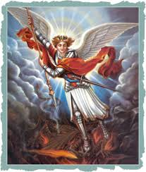
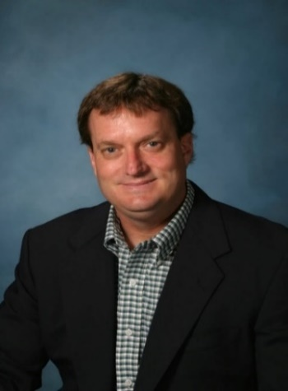
Q & A
Questions?
Insights 21 Podcast @ www.Insights21.com or
www.DrMichaelJFredrick.com
Dr. Michael J Fredrick, LLC
Insights 21 Podcast = YT, Bitchute, Rumble Email: mjfinsights21@gmail.com
The strongest people make time to help others, even if they are struggling with their own problems.
The best way to find yourself, is to lose yourself in the service of others. -Gandhi
*If a society will not protect the children, then God will not protect them!

